Slide 1
Deep Learning for Semantic Segmentation of Atolls
DREW HINTON, GORDON DOORE, SAMEER KHAN
TEAM Ai-ZOOM
PACIFIC ATOLLS

Slide 2
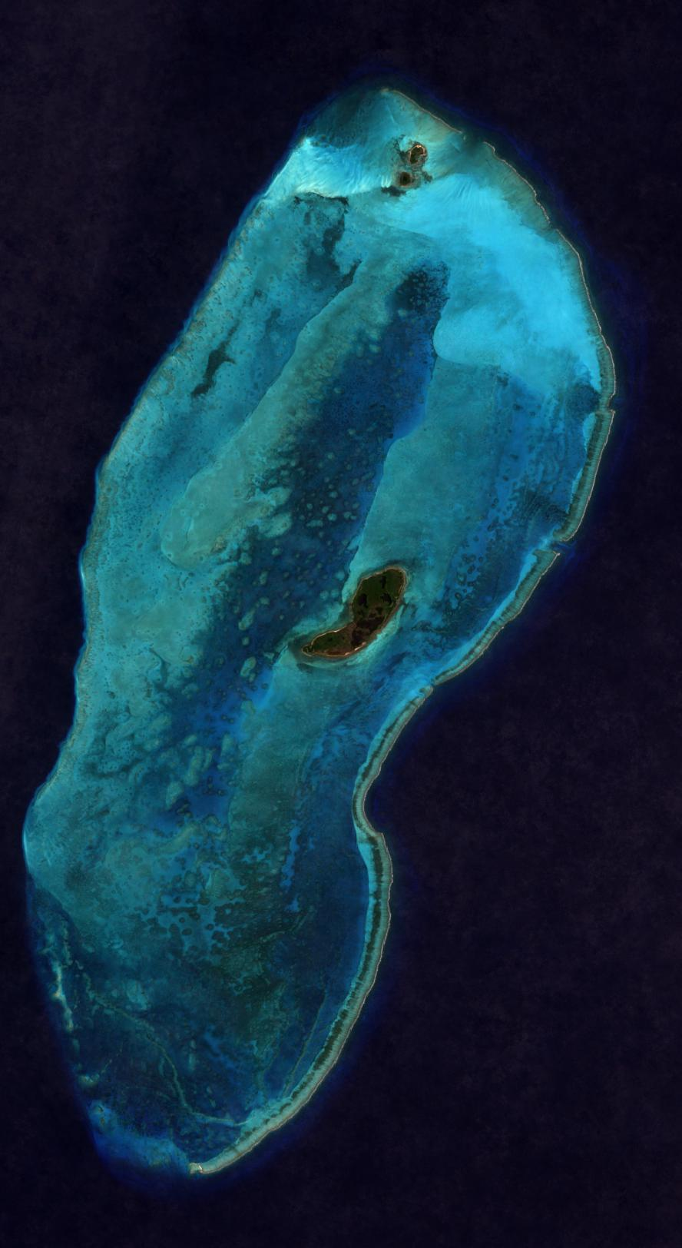
DATA
Data: Aerial imagery of pacific atolls in various color settings and a parallel set of labels produced via k-means clustering.
Size: Small. 290 viable images.
Collection: Various atolls across the pacific from a satellite, then channels put together to create different representations of atolls.
Preprocessing and Cleaning: Removed images with low resolution, use NIR
Provided Labels: We were also given a set of labels produced via k-means clustering (a shallow learning technique).
Figure: Sample Image from our dataset (Unlabeled)

Slide 3
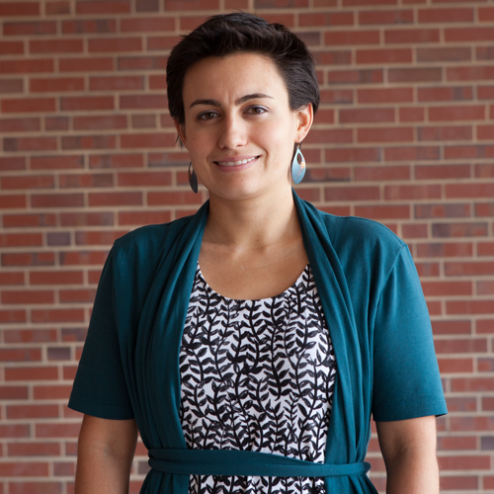
PROBLEM
Mission: To determine and analyze where coral reefs are in image
Data-set Provider: Geology Professor Alejandra Geiger-Ortiz
How can we translate it into computer vision components/tasks?
This quickly became a semantic segmentation problem. This means pixel-level classification. Assigning each pixel in the image to a class.
A lot of work has been done using U-Net architecture for semantic segmentation of aerial imagery. This precedent was especially useful as we implemented U-Net

Slide 4
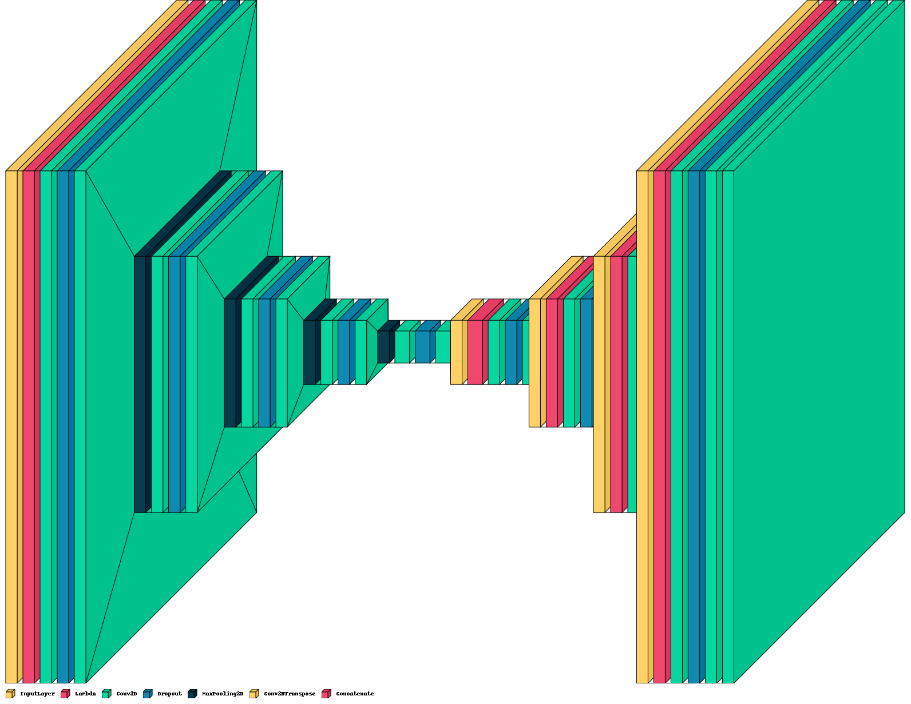
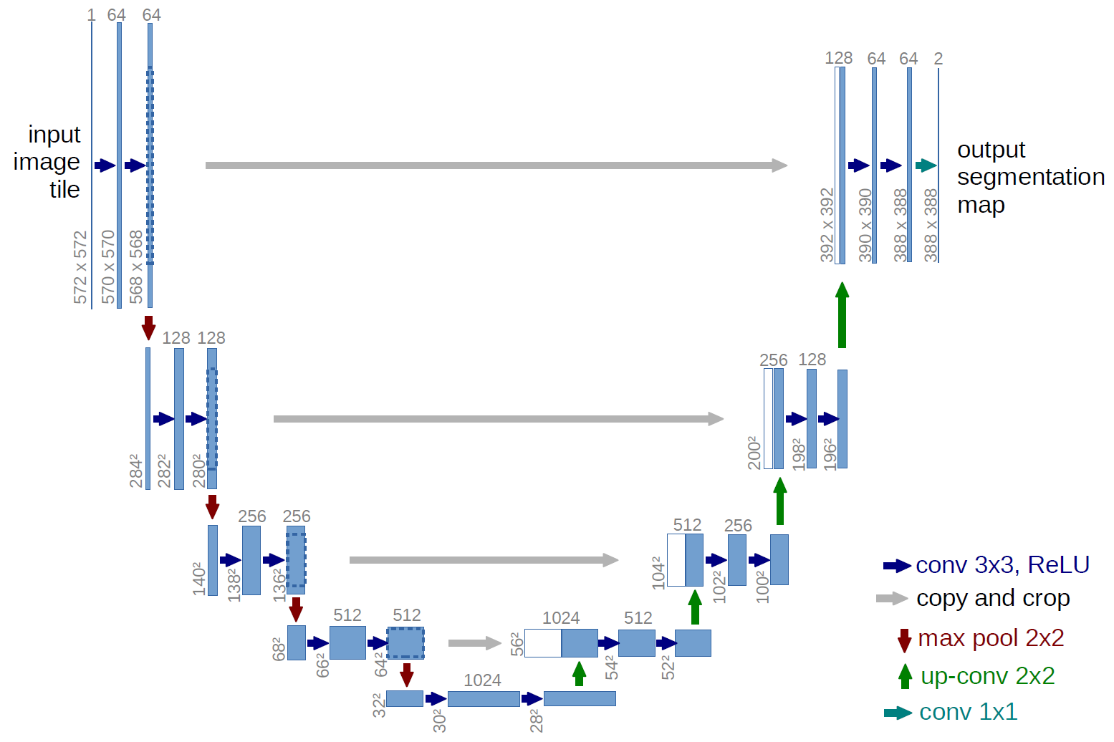
U-Net architecture
In U-Net, an image is converted into a vector and then the same mapping is used to convert it again to an image. This reduces the distortion by preserving the original structure of the image.
Olaf Ronneberger et al. U-Net: Convolutional Networks for Biomedical Image Segmentation.
Notes:
What is the significance of these images here? add small caption
As we talked about U-Net architecture in slide 3, try it to give it in slide 4

Slide 5
ANNOTATION
Labeling: Three classes: vegetation, reef flat, and ocean.
Labeling tool: Dash-doodler: 70 images labeled
Note: As we tested these with our base model, we found that the k-means labeled data that we were given were more accurate, and gave the model stronger performance.
Notes:
Provide images to help the audience visualize

Slide 6
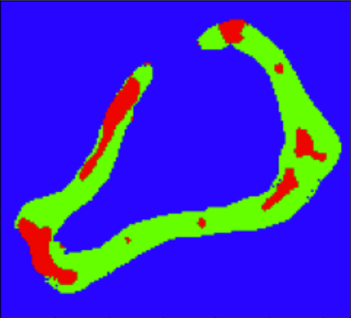
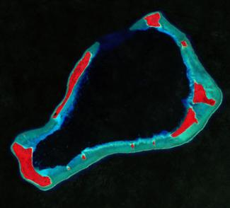
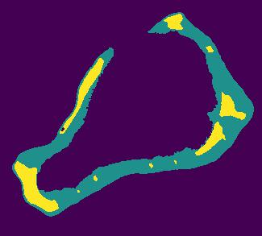
Doodler vs k-means

Slide 7
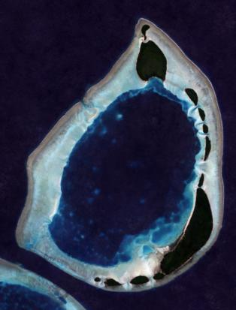
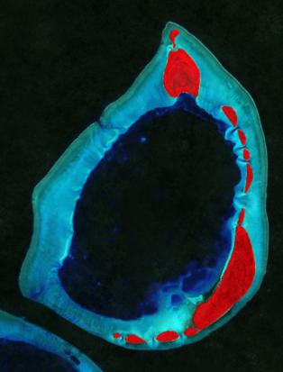
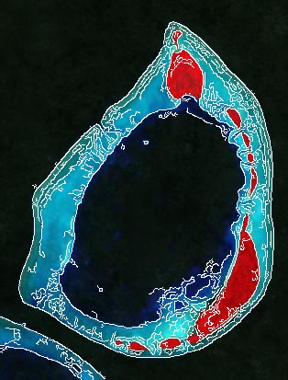
PREPROCESSING/AUGMENTATION
Steps:
NIR Images
Resize to 224 or 448 (RAM dependent)
Augment by rotation
Notes:
Too many words

Slide 8
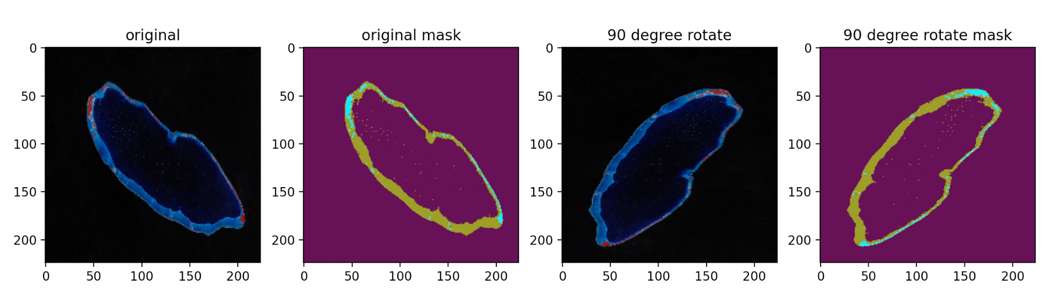
Data Augmentation

Slide 9
MODELING
Approach 1: U-Net with dashdoodler labels
Approach 2: U-Net with k-means clustering labels
Approach 3: Transfer Learning/ Fine-tuning with SegFormer
U-Net Implementation from Dr. Sreenivas Bhattiprolu
U-Net architecture: Ronneberger et. al
SegFormer architecture from Enze Xie et al. SegFormer: Simple and Efficient Design for Semantic Segmentation with Transformers.
Notes:
Any image if possible. Simple, the better

Slide 10
RESULTS
Model | Size | Label-set | Mean IoU | Vegetation IoU | Reef IoU | Ocean IoU | Time/Img (microsecs)
aiZoom-atolls-w-kmeans-8 | 22MB | k-means | 0.942 | 0.931 | 0.922 | 0.974 | 1
aiZoom-atolls-doodler-2 | 22MB | doodler | 0.918 | 0.848 | 0.924 | 0.980 | 3
aiZoom-atolls-transformer-2 | 14MB | doodler | 0.853 | 0.835 | 0.764 | 0.962 | 2
Notes:
Add some metrics (if you can). Like how much time?

Slide 11
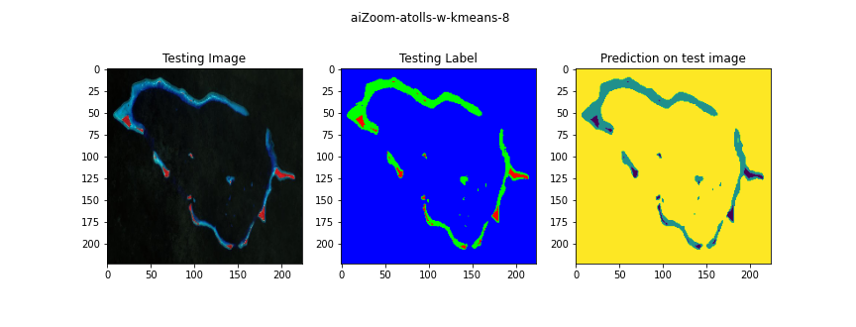
In some situations the model can pick up finer details than the label

Slide 12
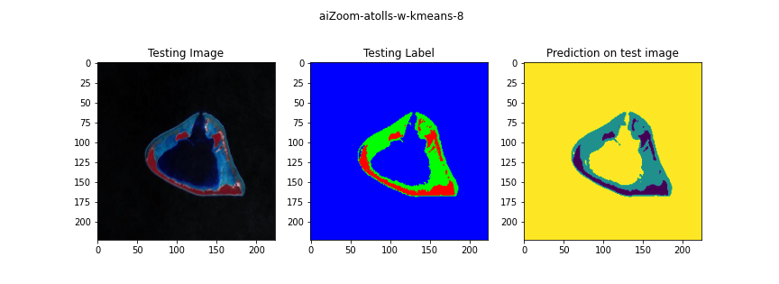
sometimes reef classification was a bit too aggressive

Slide 13
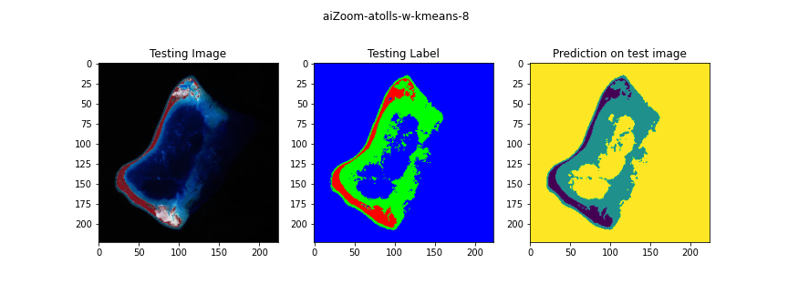
And sometimes it was spot on

Slide 14
USAGE
How would we or other people use this?
Finding changes over time in the size of reefs
Satellite imagery transfer learning
Limitations and biases: Due to broadness of reef-flat class, there is some ambiguity between it and ocean class. This means that often labels and predictions will not match and also that the prediction tends to outperform the label within the parameters of the class.

Slide 15
CONCLUSIONS AND FUTURE WORK
In the future, it would make sense to relabel data for an additional two classes: shallow ocean and sand. This will allow for a strong distinction to be made between reef flat, ocean and the other classes.
However, it is very clear that this structure for a model is very strong for semantic segmentation of high contrast images such as these.
Additionally, more work on transfer learning could help to create a strong model more efficiently than training from scratch.

Slide 16
ACKNOWLEDGEMENT
Thanks to Prof. Tahiya Chowdhury
Thanks to Prof. Stent
Thanks to Prof. Ortiz
Thank you so much!
FROM DREW HINTON, GORDON DOORE, SAMEER KHAN

